Slide 1
Internship Report
On
GharVada
Puspendra Birajee
22A91A05J7
IV Year & CSE Department
Aditya Engineering College (AEC)

Slide 2
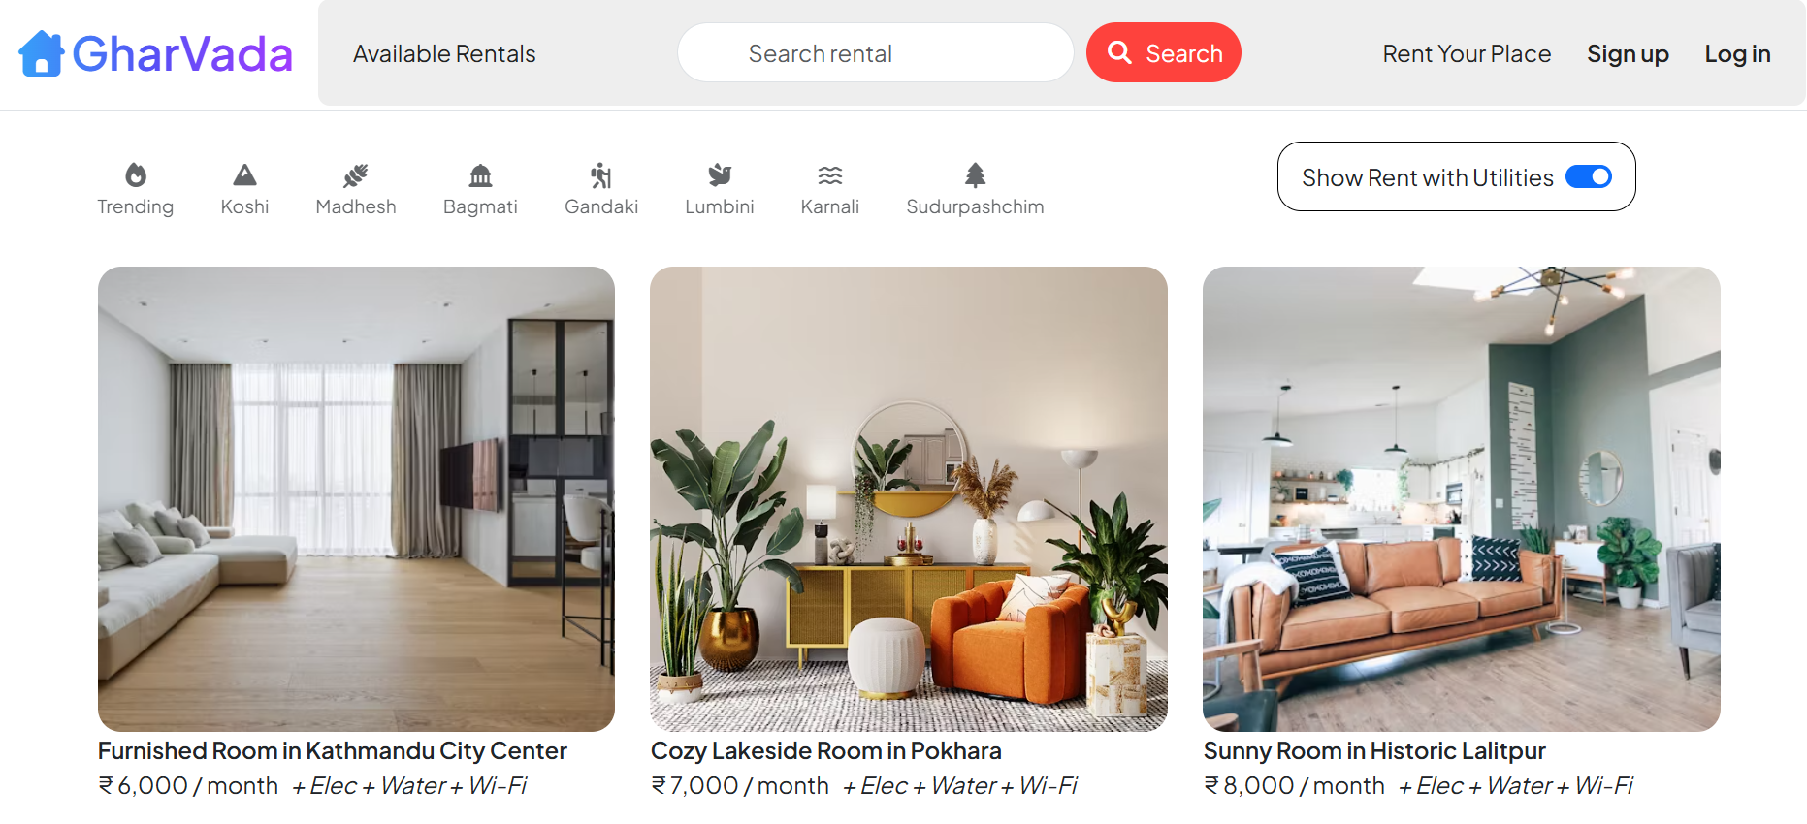
GharVada
Presentation Overview
Introduction
Objectives
Tools & Technologies Used
Features
System Design & Architecture
Screenshots / Demo
Outcome / Results
Future Enhancements
Conclusion

Slide 3

GharVada
Introduction
Simple and user-friendly website for renting homes, rooms, offices, or listing own property.
Connects property owners and renters in one place.
Shows important details – price, location, pictures, description and owner contact .
Built using full-stack development, responsive design, and deployment skills.
Goal to help finding or renting property quick and convenient.

Slide 4


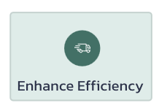
GharVada
Objectives
Make it easy for people to find rental homes, rooms, or offices without middlemen
Give property owners a simple way to list their places online
Show all important details like price, location, pictures, map, and reviews
Create a fast, safe, and mobile-friendly website
Build and deploy the project using full-stack development skills

Slide 5

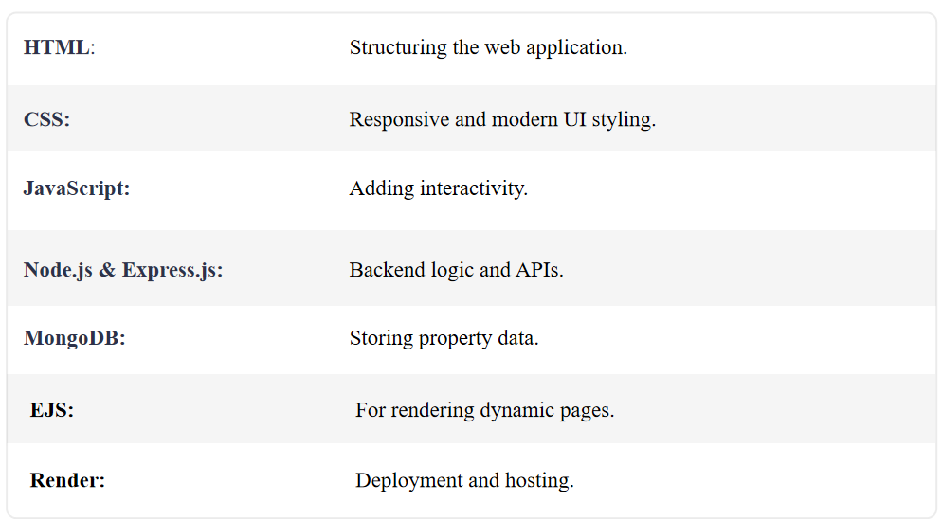


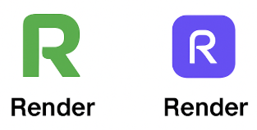
GharVada
Tools & Technologies Used

Slide 6
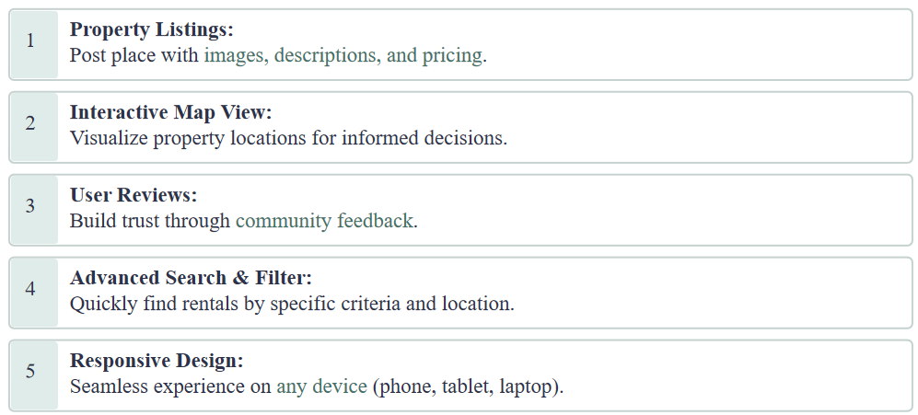
GharVada
Features

Slide 7
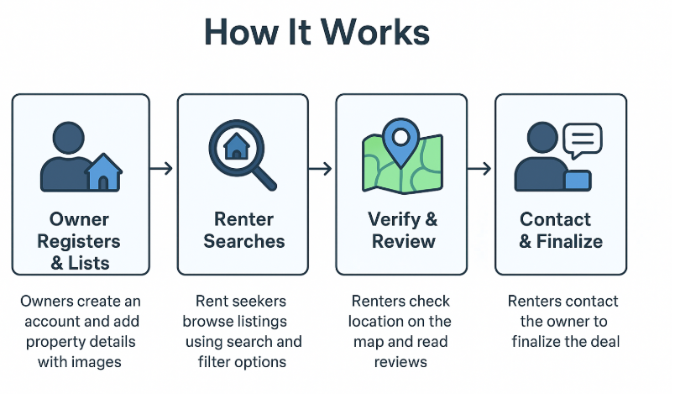
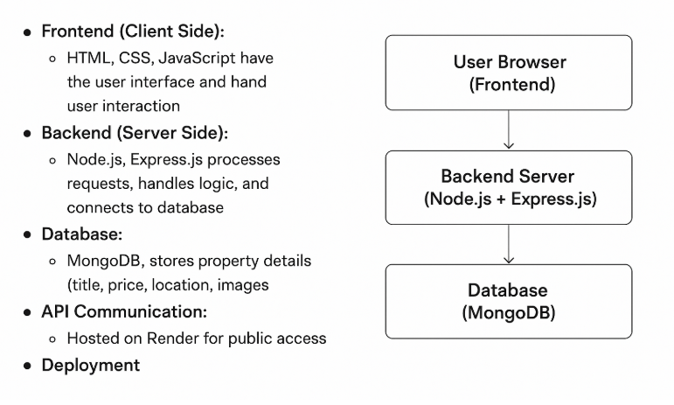
GharVada
System Desgin & Architecture

Slide 8
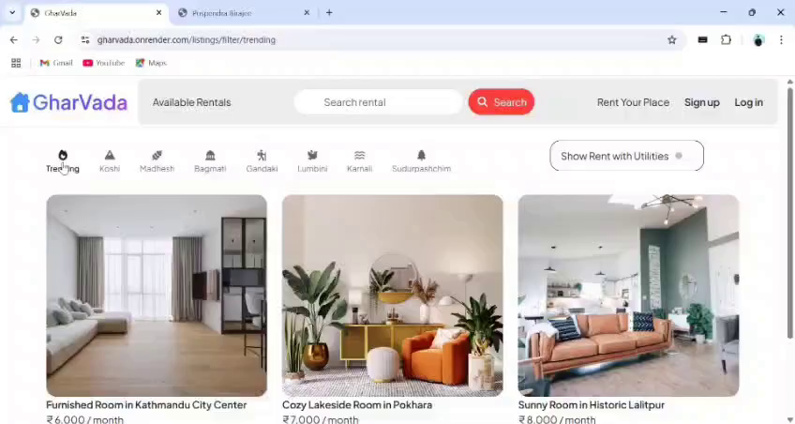
GharVada
Screenshots / Demo CheckLive
Homepage
Sign up / Log in
Property Listing Page
Property Details Page
Owner Dashboard
Reviews & Map Location

Slide 9
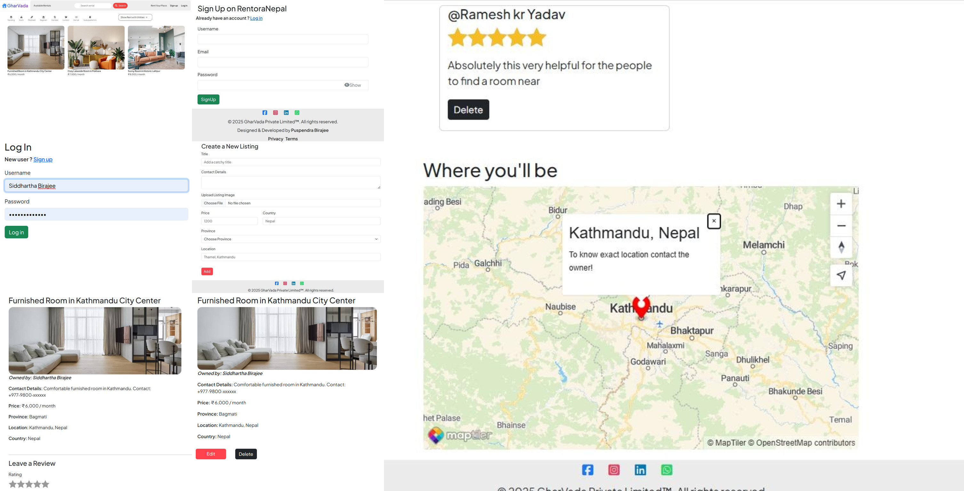
GharVada
Screenshots / Demo

Slide 10
GharVada
Outcome / Results
Successfully developed a user-friendly property rental platform.
Enabled quick property listing and easy search with filters.
Improved transparency with map location & reviews.
Reduced time for renters and owners to connect and finalize deals.
Mobile-friendly and responsive design for better accessibility.

Slide 11
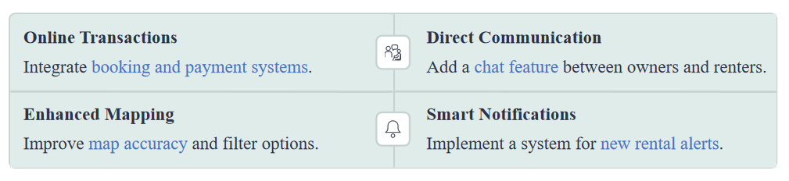
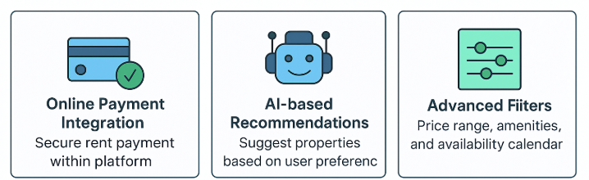

GharVada
Future Enhancement

Slide 12
GharVada
Conclusion
GharVada successfully addresses the gap between property owners and renters by providing a simple, user-friendly, and efficient platform.
With features like property listing, search filters, map verification, and direct communication, it makes the rental process faster, more transparent, and more convenient.
This project demonstrates practical implementation of web technologies and sets the foundation for future enhancements like AI recommendations, secure payments, and multilingual support.

Slide 13
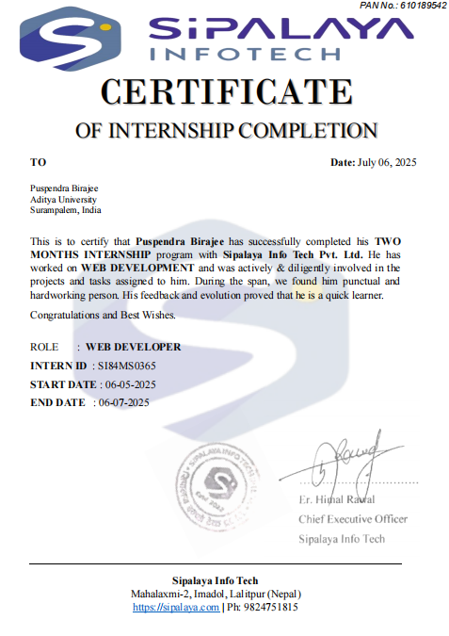
Internship Certificate

Slide 14
Websites & Online Resources
Node.js Official Documentation – Used to understand backend server creation, event-driven architecture, and handling asynchronous operations.
Express.js Guide – Referred for building RESTful APIs, routing, and middleware implementation.
MongoDB Documentation – Helped in designing collections, managing queries, and integrating the database using Mongoose.
EJS Official Documentation – Used to render dynamic web pages and pass backend data to the frontend templates efficiently.
Bootstrap Documentation – Referred for building a responsive and user-friendly interface with reusable components.
MapTiler Documentation – Used to integrate interactive maps and display property locations within the website.
MDN Web Docs – Detailed explanations for JavaScript functions, ES6 syntax, and API usage during development.
References

Slide 15
Thank You

